Slide 1


Human-AI Capstone Sprint
Sean
2025/01/01

Slide 2


CONTENTS
Capstone Kick-off
01
Guiding Principles
02
Workflow Blueprint
03
Showcase & Feedback
04
Reflection & Next Steps
05
Takeaways & Closure
06

Slide 3


Part.
01
Capstone Kick-off

Slide 4
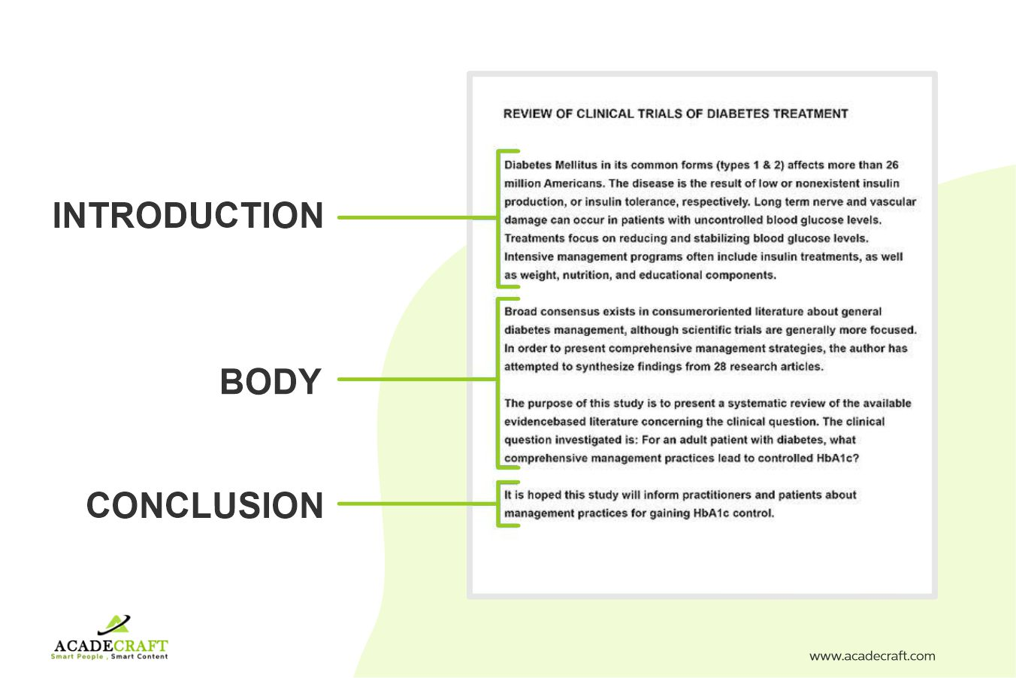
Your Mission: Human-AI Co-Creation
This capstone unites every prior lesson—prompting, generative and agentic AI, ethics, privacy, oversight—into one tangible project. You choose the domain, define the purpose, and invite AI in as a creative partner, not a substitute . Success is measured by thoughtful iteration, responsible choices, and clear reflection on how human vision guided every machine suggestion.

Slide 5
Project Menu: Pick Your Passion
Creative Writing
Digital Art & Multimedia
Learning & Study Tools
Poems, stories, essays
Images, video, music
Summaries, flashcards
Professional Projects
Personal Productivity
Business plans, automation
AI-assisted planners, schedules, habit trackers

Slide 6
Part.
02
Guiding Principles

Slide 7
Human Vision First, AI Second
Begin by articulating purpose, target audience, and desired impact; let these goals steer every subsequent prompt and model selection. AI accelerates exploration, yet human judgment sets constraints, evaluates cultural fit, and ensures outputs remain aligned with original intent, preventing technological determinism from overriding personal or organizational values.

Slide 8
Ethical Guardrails in Practice
Apply Module 4-7 frameworks: secure consent, cite transparently, audit for bias, and maintain human oversight. Document each decision in a running log.
Secure Consent
Cite Transparently
Human Oversight
Audit for Bias

Slide 9
AI Output (Draft Zero)
Iterate with Intent
Critique & Reflect
Treat every AI output as draft zero : critique, refine, and improve. Schedule micro-reviews to capture lessons and avoid compounding errors.
Refine Prompts & Parameters
Improved Output

Slide 10
Part.
03
Workflow Blueprint

Slide 11
Plan: Scope, Roles, & Success Metrics
Define Scope
Set Metrics
Set deliverable boundaries to prevent scope creep.
Allocate Roles
Define success with measurable criteria like clarity and usability.
Assign tasks between human and AI collaborators.

Slide 12
1. Craft Context-Rich Prompts
Create: Prompt, Generate, Evaluate
2. Run Generative Models
Dedicate a focused block to active co-creation. Rapid experimentation coupled with instant critique keeps momentum high and surfaces unexpected model strengths early.
3. Capture & Score Variants

Slide 13
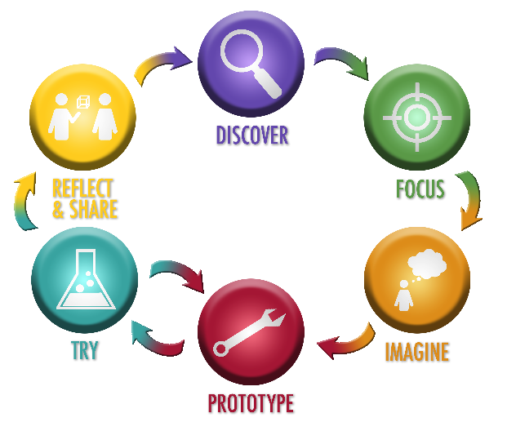
Reflect: Document & Refine
Pause to log your process. This converts experience into explicit knowledge, ensuring the next cycle starts from a higher baseline.
What succeeded and why?
Where did AI misinterpret intent?
Which ethical risks emerged?
How were prompts adjusted?

Slide 14
Part.
04
Showcase & Feedback

Slide 15
Present Process Over Perfection
Five-minute demos prioritize narrative. Peers evaluate the clarity of human judgment, creativity of prompt strategy, and rigor of oversight—not just polish.
1. State Your Original Goal
2. Show Key AI Iterations
3. Highlight Ethical Decisions
4. Share Final Learnings

Slide 16
Peer Feedback Framework
Audience asks three questions, keeping critique constructive and focused on transferable lessons to foster a community of continuous, responsible AI adoption.
+
+
What Worked Well?
What Surprised You?
What to Improve?

Slide 17
Part.
05
Reflection & Next Steps

Slide 18
Self-Assessment Checklist
Key Takeaway
Rate yourself honestly to personalize your learning path and build evidence for your AI fluency.
Identify one strength to leverage and one gap to address in your next project.
Prompting Precision
Ethical Diligence
Iterative Discipline
Communication Clarity

Slide 19
Scale-Up Ethics Challenge
Imagine your project at a societal scale. Consider data consent, bias, energy, and displacement. Draft three additional oversight measures.
Explainability Dashboards
Human-in-the-Loop
Third-Party Audits

Slide 20
Part.
06
Takeaways & Closure

Slide 21
Core Lessons Solidified
AI augments human creativity yet demands vigilant oversight.
Iteration without reflection breeds error; process matters.
Ethical principles must be operationalized, not memorized.
Clear communication of process builds trust and understanding.
Responsible experimentation today shapes inclusive, sustainable AI tomorrow.

Slide 22

Competency Achievement Map
You can now innovate across disciplines while safeguarding human values, compliance, and societal wellbeing.
Design purposeful prompts.
Integrate AI responsibly.
Critique outputs for risks.
Iterate with reflection.
Articulate insights clearly.

Slide 23
From Project to Portfolio
Package your work into a shareable portfolio piece. This curated evidence validates your readiness for contexts where human-centered AI fluency is the decisive edge.
Charter
Prompt Log
Ethical Audit
Reflection
Shareable Portfolio Piece

Slide 24
Thank You & Keep Iterating
Celebrate experimentation, stay curious, and keep refining both prompts and principles. The capstone ends today; your responsible AI journey begins now.
Share successes, report failures, mentor others, and champion oversight—because the future of human-AI collaboration depends on leaders who dare to iterate ethically and inclusively.

Slide 25
THANK YOU
Sean
2025/01/01

